Slide 1
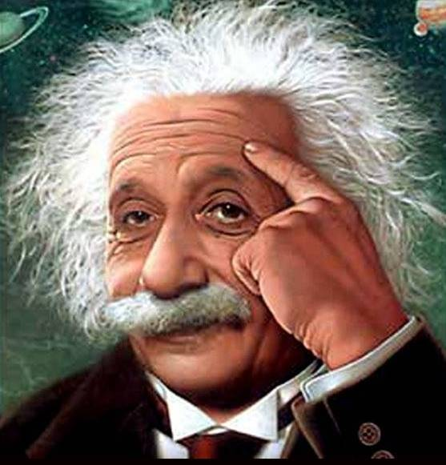


Life Lessons From Einstein

Slide 2
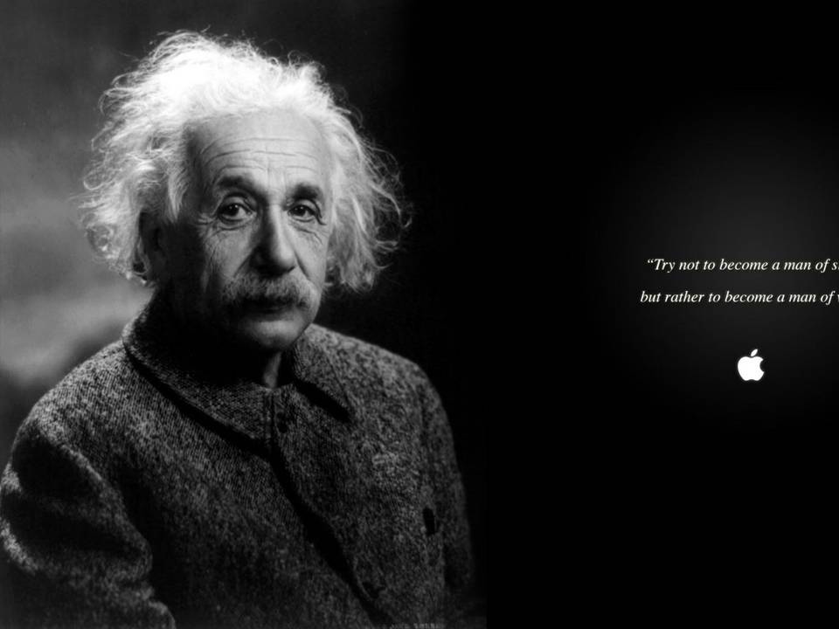
Albert Einstein has long been considered a genius by the masses. He was a theoretical physicist, philosopher, author, and is perhaps the most
influential scientists to ever live.

Slide 3
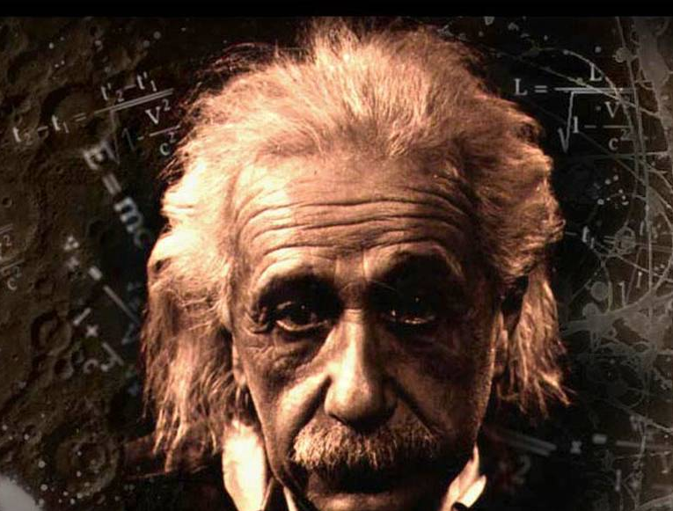
Einstein has made great contributions to the scientific world, including the theory of relativity, the founding of relativistic cosmology, the prediction of the deflection of light by gravity, the quantum theory of atomic motion in solids, the zero-point energy concept, and the quantum theory of a monatomic gas which predicted Bose–Einstein condensation, to name a few of his scientific contributions.

Slide 4
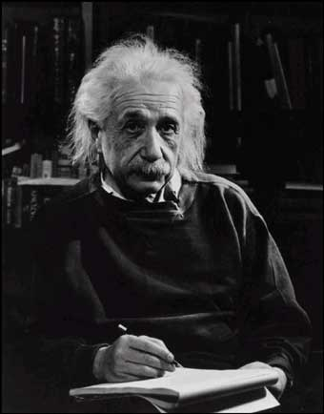
Einstein received the 1921 Nobel Prize in Physics “for his services to Theoretical Physics, and especially for his discovery of the law of the photoelectric effect.”
He’s published more than 300 scientific works and over 150 non-scientific works. Einstein is considered the father of modern physics and is probably the most successful scientist there ever was. Here are 10 Amazing Lessons from Albert Einstein:

Slide 5

Life Lesson 1 : Follow Your Curiosity
What piques your curiosity? I am curious as to what causes one person to succeed while another person fails; this is why I’ve spent years studying success. What are you most curious about? The pursuit of your curiosity is the secret to your success.

Slide 6
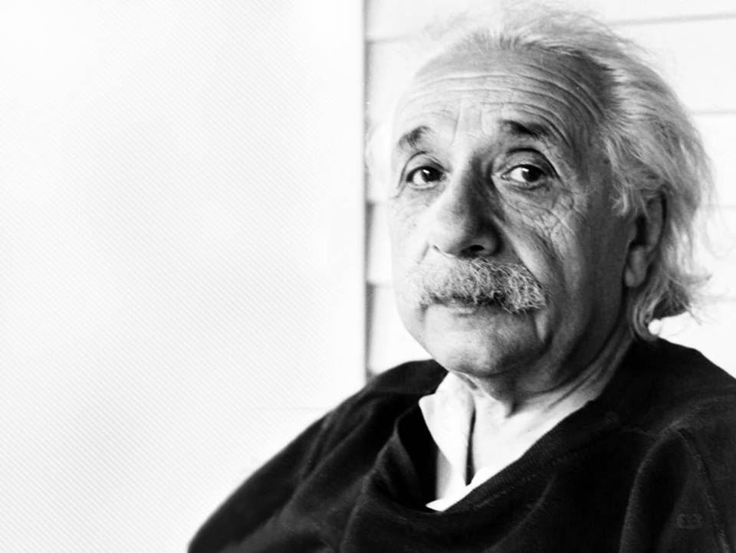
“I have no special talent. I am
only passionately curious.”

Slide 7
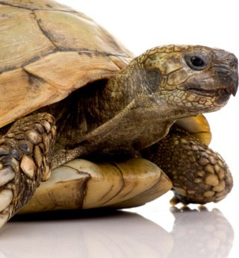
Life Lesson 2 : Perseverance is Priceless
Through perseverance the turtle reached the ark. Are you willing to persevere until you get to your intended destination? They say the entire value of the postage stamp consist in its ability to stick to something until it gets there. Be like the postage stamp; finish the race that you’ve started!

Slide 8
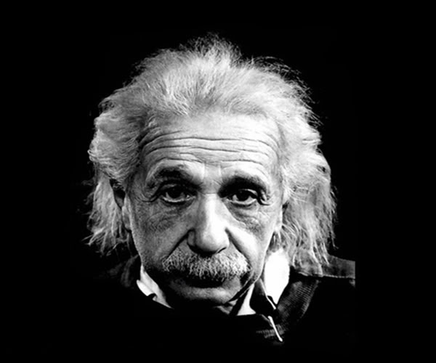
“It's not that I'm so smart; it's just
that I stay with problems longer.”

Slide 9

Life Lesson 3 : Focus on the Present
My father always says you cannot ride two horses at the same time. I like to say, you can do anything, but not everything. Learn to be present where you are; give your all to whatever you’re currently doing. Focused energy is power, and it’s the difference between success and failure.

Slide 10
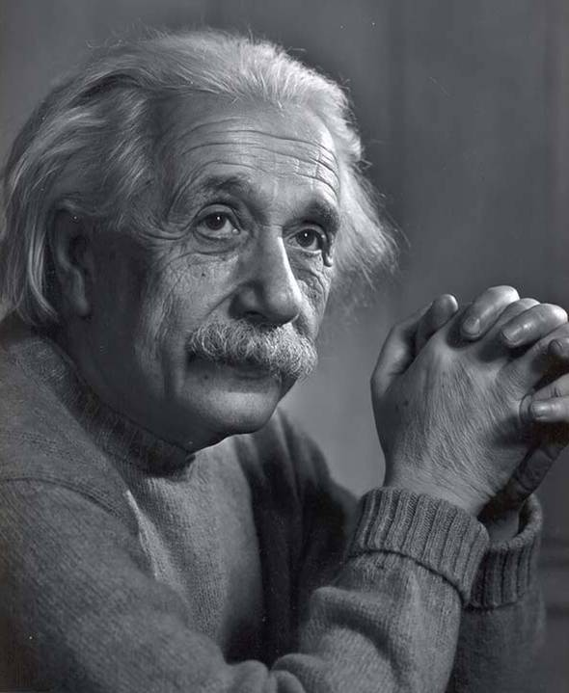
“Any man who can drive safely while kissing a pretty girl is simply not giving the kiss the attention it deserves.”

Slide 11

Life Lesson 4 : The Imagination is Powerful
Your imagination pre-plays your future. Einstein went on to say, “The true sign of intelligence is not knowledge, but imagination.” Are you exercising your “imagination muscles” daily, don’t let something as powerful as your imagination lie dormant.

Slide 12
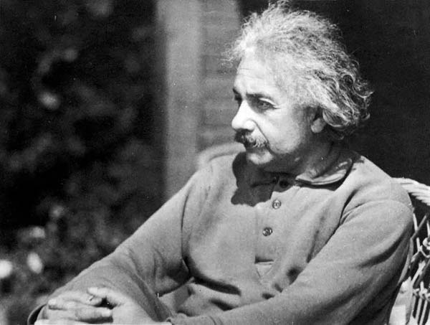
“Imagination is everything. It is the preview of
life's coming attractions. Imagination is more
important than knowledge.”

Slide 13

Life Lesson 5 : Make Mistakes
Never be afraid of making a mistake. A mistake is not a failure. Mistakes can make you better, smarter and faster, if you utilize them properly. Discover the power of making mistakes. I’ve said this before, and I’ll say it again, if you want to succeed, triple the amount of mistakes that you make.

Slide 14
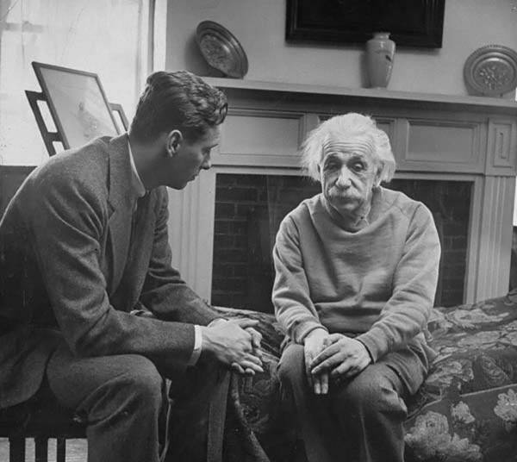
“A person who never made a mistake never tried anything new.”

Slide 15

Life Lesson 6 : Live in the Moment
You cannot “presently” change yesterday or tomorrow, so it’s of supreme importance that you dedicate all of your efforts to “right now.” It’s the only time that matters, it’s the only time there is.

Slide 16
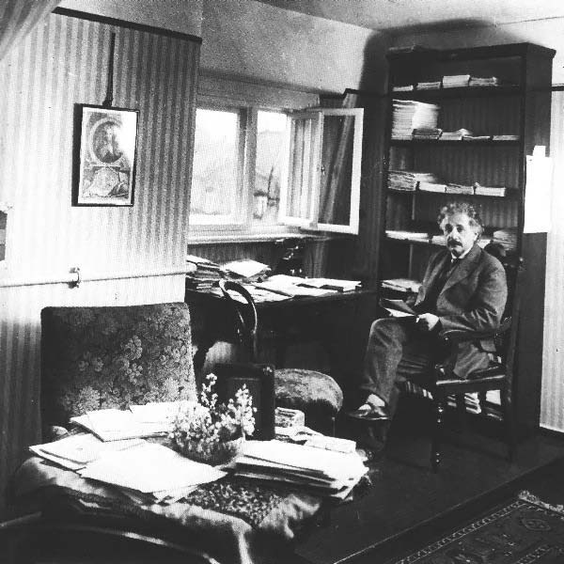
“I never think of the future - it comes soon enough.”
The only way to properly address your future is to be as present as possible “in the present.”

Slide 17

Life Lesson 7 : Create Value
Don’t waste your time trying to be successful, spend your time creating value. If you’re valuable, then you will attract success. Discover the talents and gifts that you possess, learn how to offer those talents and gifts in a way that most benefits others. Labor to be valuable and success will chase you down.

Slide 18
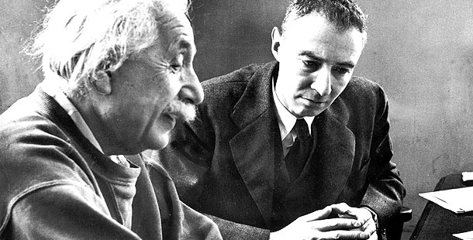
“Strive not to be a success,
but rather to be of value."

Slide 19
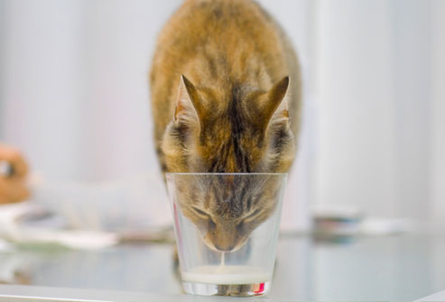
Life Lesson 8 : Don’t Expect Different Results
You can’t keep doing the same thing everyday and expect different results. In other words, you can’t keep doing the same workout routine and expect to look differently. In order for your life to change, you must change, to the degree that you change your actions and your thinking is to the degree that your life will change.

Slide 20
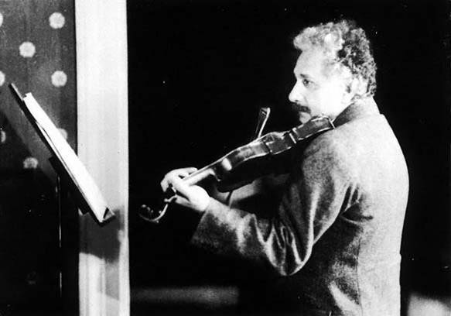
“Insanity: doing the
same thing over
and over again
and expecting
different results.”

Slide 21
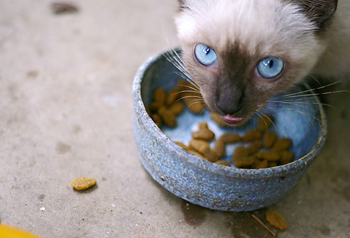
Life Lesson 9 : Knowledge Comes From Experience
Knowledge comes from experience. You can discuss a task, but discussion will only give you a philosophical understanding of it; you must experience the task first hand to “know it.” What’s the lesson? Get experience! Don’t spend your time hiding behind speculative information, go out there and do it, and you will have gained priceless knowledge.

Slide 22
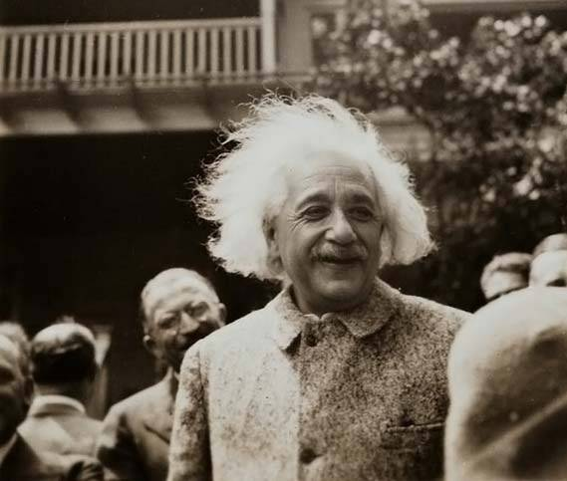
“Information is not
knowledge. The only
source of knowledge
is experience.”

Slide 23

Life Lesson 10 : Learn the Rules and Then Play Better
To put it all in simple terms, there are two things that you must do. The first thing you must do is to learn the rules of the game that you’re playing. It doesn’t sound exciting, but it’s vital. Secondly, you must commit to play the game better than anyone else. If you can do these two things, success will be yours!

Slide 24
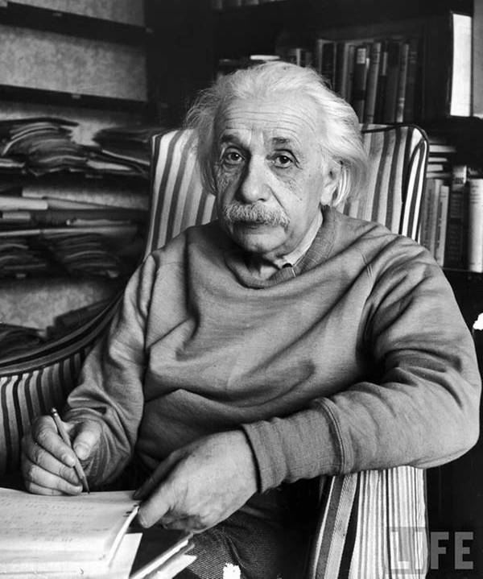
“You have to learn the rules of the
game. And then you have to play
better than anyone else.”

